Slide 1
Listening in academic contexts
Dr Vinod Bhatt

Slide 2
The following is a typical structure in such a listening-oriented class:
Pre- listening discussion
Pre-listening vocabulary
Dealing with Unknown Vocabulary
Subject-specific vocabulary
Listening for gist
Listening for specific information
Listening for detailed information
Post listening information
Listening to Multiple Speakers- group discussion & class seminars

Slide 3
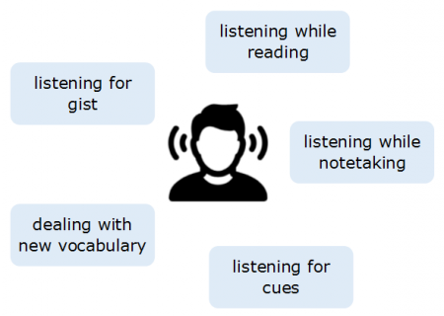
Lectures

Slide 4
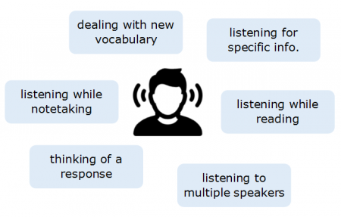
Seminars

Slide 6
Thanks

